Slide 1
Identifying CTCF Binding Using a DNA GpC Methyltransferase in vivo

Slide 2
Contents
Background Information
Experimental Procedures
Current Research Progress and Future Plan
Acknowledgements

Slide 3
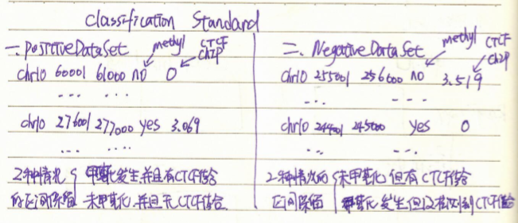
Classification Standard (WRONG)
Define positive data set: CTCF binding can be predicted by methylation; negative data set: CTCF binding cannot be predicted by methylation.

Slide 4
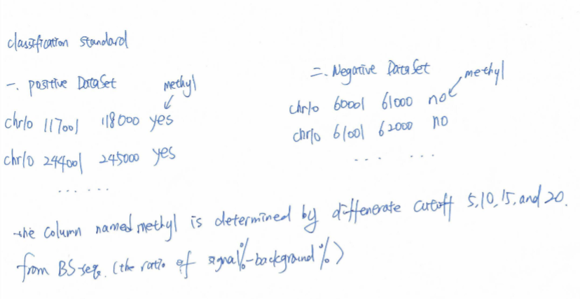
Classification Standard (Revised)
Define positive data set: methylation regions; negative data set: unmethylation regions.

Slide 5
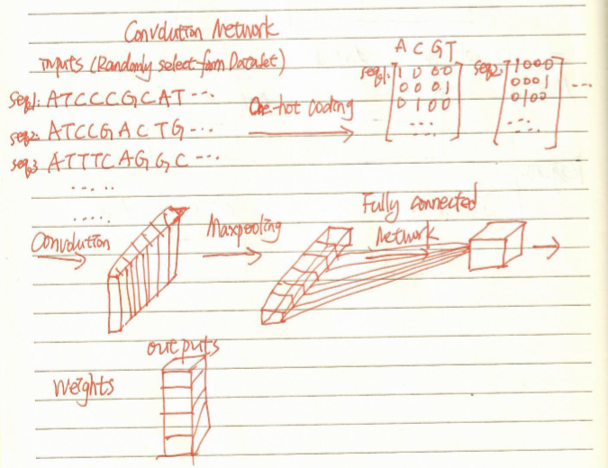
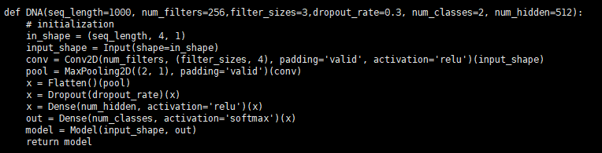
Try
For calculating the weight values (w), we use 60% data for training as training dataset, and 40% data for validating as validation dataset.
For each process of rectifying w, we split 20% training data for validation.
We used mean squared error (MSE) as loss function, and accuracy as metrics function.

Slide 6
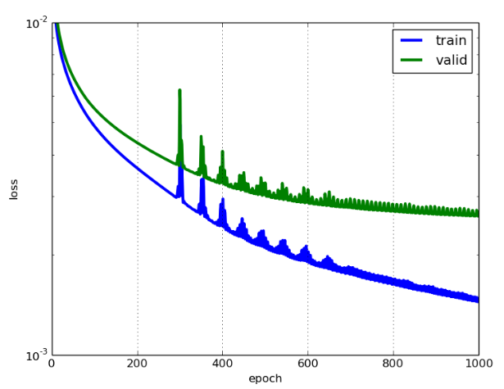
Some Conceptions
The lower the loss, the better a model (unless the model has over-fitted to the training data). The loss is calculated on training and validation and its interpretation is how well the model is doing for these two sets. Unlike accuracy, loss is not a percentage. It is a summation of the errors made for each example in training or validation sets. Loss value implies how well or poorly a certain model behaves after each iteration of optimization. Ideally, one would expect the reduction of loss after each, or several, iteration(s).
The accuracy of a model is usually determined after the model parameters are learned and fixed and no learning is taking place. Then the test samples are fed to the model and the number of mistakes (zero-one loss) the model makes are recorded, after comparison to the true targets. Then the percentage of misclassification is calculated.
For example, if the number of test samples is 1000 and model classifies 952 of those correctly, then the model's accuracy is 95.2%.

Slide 7
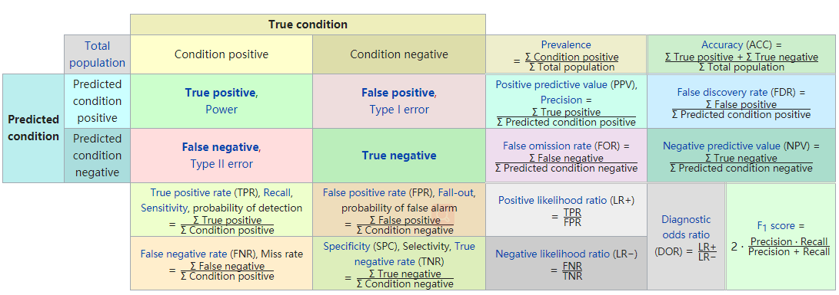
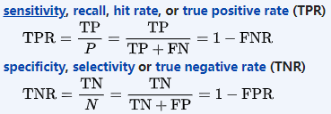
Some Conceptions

Slide 8
WorkFlow
For calculating the weight values (w), we use 60% data for training as training dataset, and 40% data for validating as validation dataset.
For each process of rectifying w, we split 20% training data for validation.
We used mean squared error (MSE) as loss function, and accuracy as metrics function.

Slide 9
Firstly, we employed this CNN to simulated data from janggu -- positive: 3897 seqs Oct4’s binding sites -- negative: 3900 seqs Mafk’s binding sites #bin=200

Slide 10
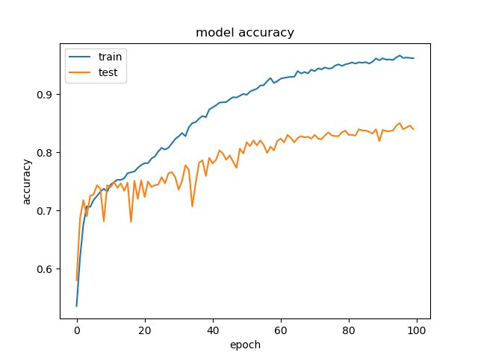
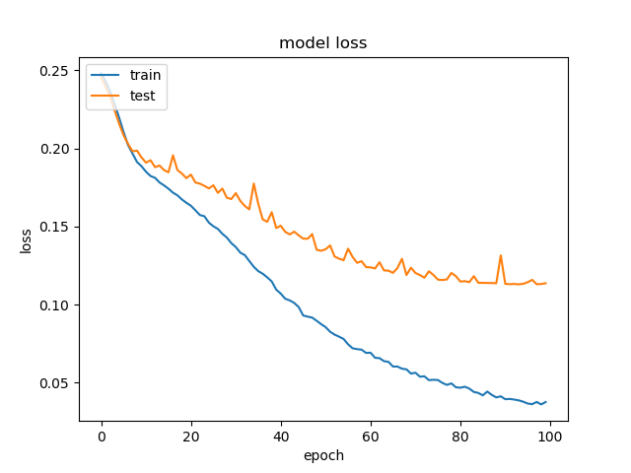
The Performance
1144 | 415
208 | 1351
Sensitivity = 0.734
Specificity = 0.867
→ This model can be used for classifying DNA sequences.

Slide 11
Next, we employed this CNN to real data

Slide 12
One Layer

Slide 13
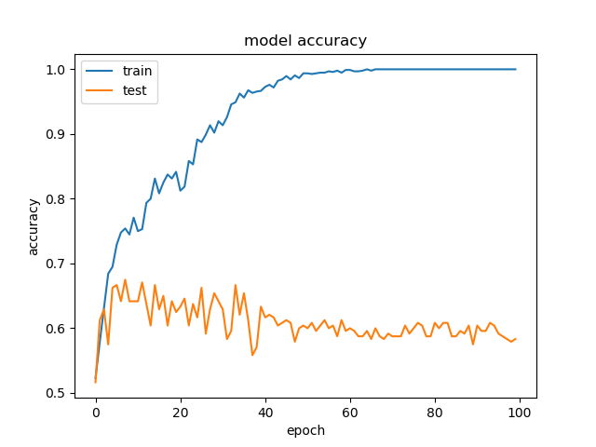
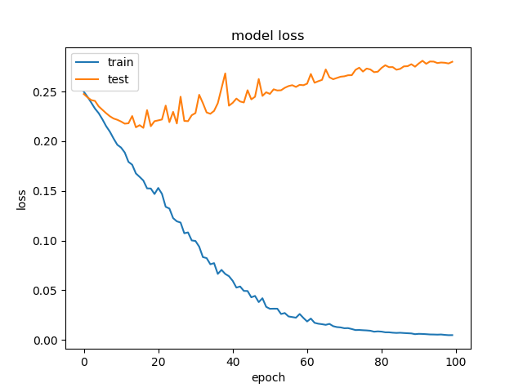
The Performance of Window Size=1K, Cutoff of avg(Methyl)=5, #Seqs=2K (1K for pos and 1K for neg)
TP | FN
FP | TN
260 | 140
184 | 216
Sensitivity = 0.65
Specificity = 0.54

Slide 14
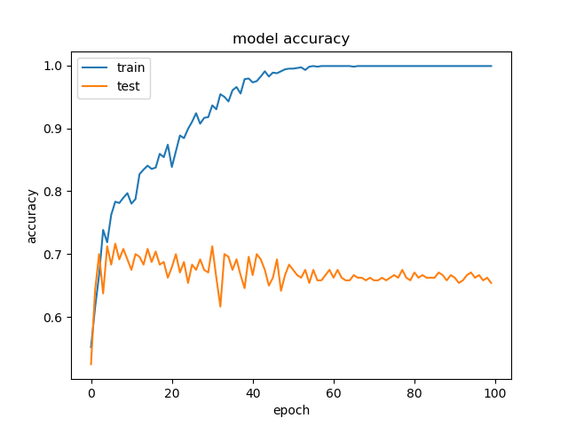
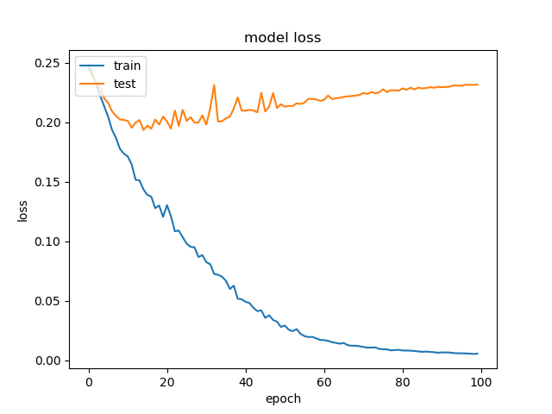
The Performance of Window Size=1K, Cutoff of avg(Methyl)=10, #Seqs=2K (1K for pos and 1K for neg)
TP | FN
FP | TN
272 | 128
134 | 266
Sensitivity = 0.68
Specificity = 0.665

Slide 15
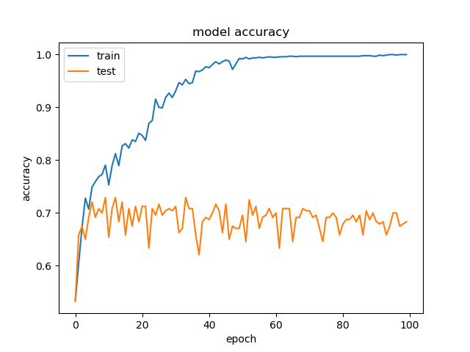
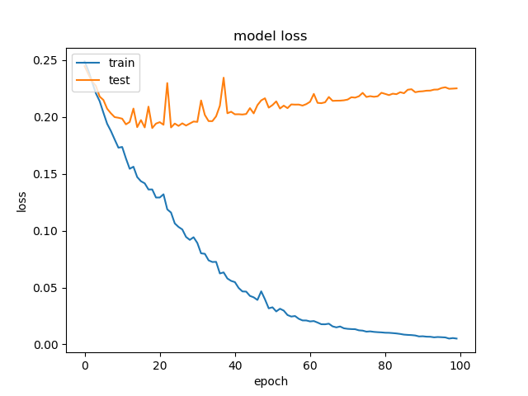
The Performance of Window Size=1K, Cutoff of avg(Methyl)=15, #Seqs=2K (1K for pos and 1K for neg)
TP | FN
FP | TN
303 | 97
154 | 246
Sensitivity = 0.758
Specificity = 0.615

Slide 16
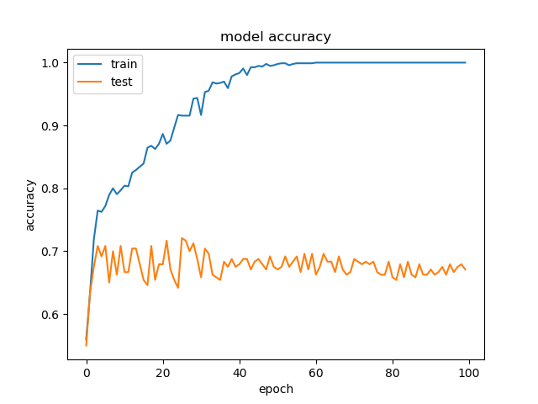
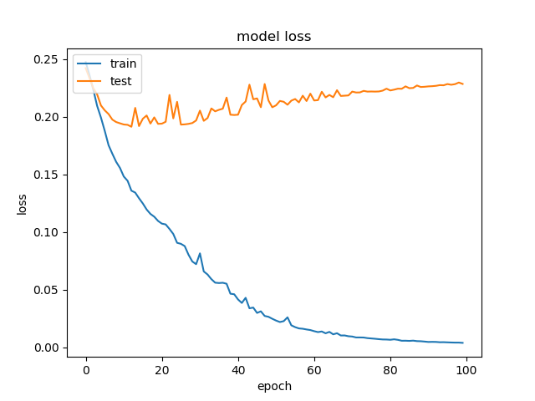
The Performance of Window Size=1K, Cutoff of avg(Methyl)=20, #Seqs=2K (1K for pos and 1K for neg)
TP | FN
FP | TN
303 | 97
141 | 258
Sensitivity = 0.758
Specificity = 0.647

Slide 17
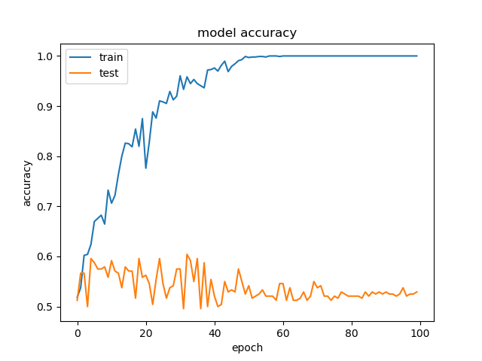
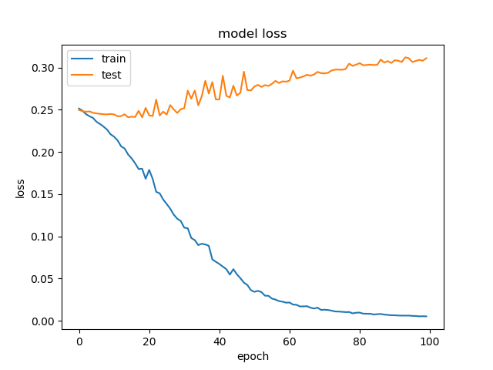
The Performance of Window Size=1K, Cutoff of max(Methyl)=5, #Seqs=2K (1K for pos and 1K for neg)
TP | FN
FP | TN
195 | 205
219 | 181
Sensitivity = 0.488
Specificity = 0.453

Slide 18
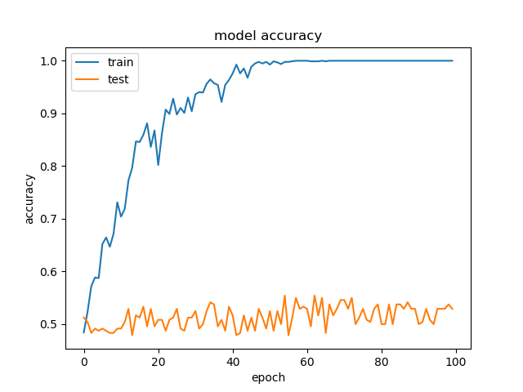
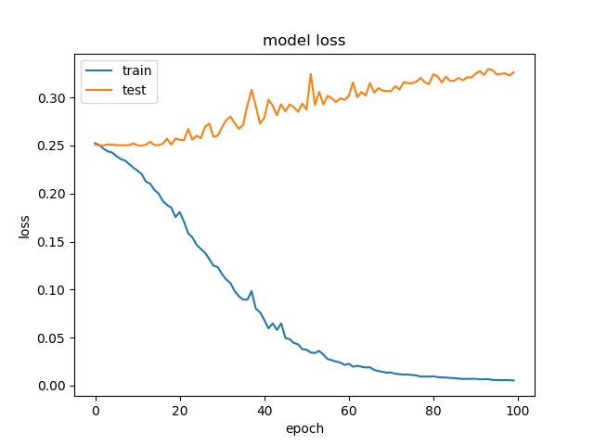
The Performance of Window Size=1K, Cutoff of max(Methyl)=10, #Seqs=2K (1K for pos and 1K for neg)
TP | FN
FP | TN
214 | 186
201 | 199
Sensitivity = 0.535
Specificity = 0.498

Slide 19
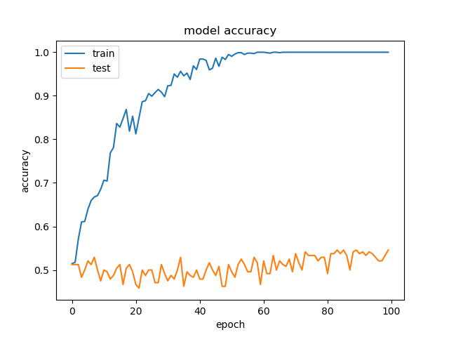
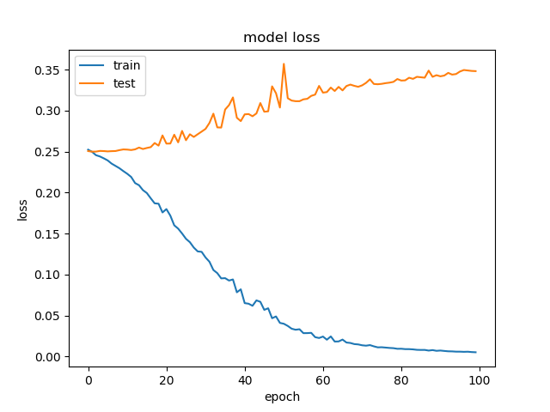
The Performance of Window Size=1K, Cutoff of max(Methyl)=15, #Seqs=2K (1K for pos and 1K for neg)
TP | FN
FP | TN
204 | 196
212 | 188
Sensitivity = 0.51
Specificity = 0.47

Slide 20
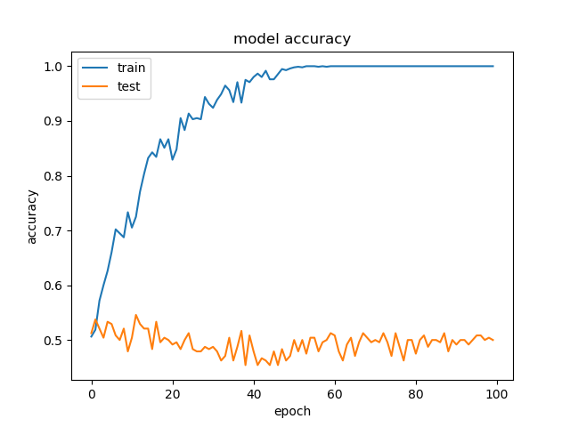
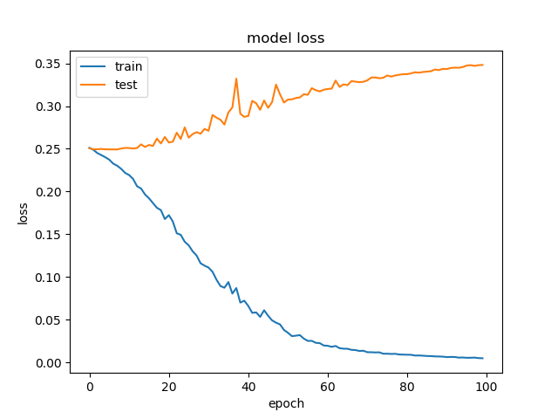
The Performance of Window Size=1K, Cutoff of max(Methyl)=20, #Seqs=2K (1K for pos and 1K for neg)
TP | FN
FP | TN
182 | 218
198 | 202
Sensitivity = 0.455
Specificity = 0.505

Slide 21
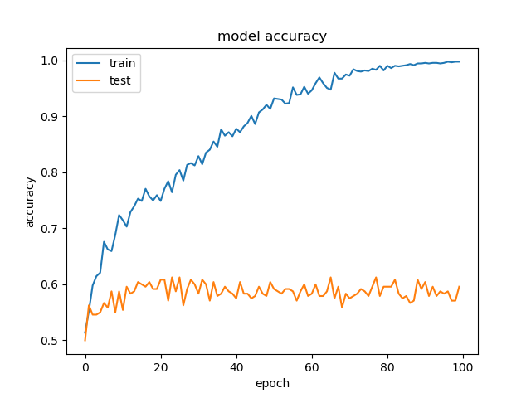
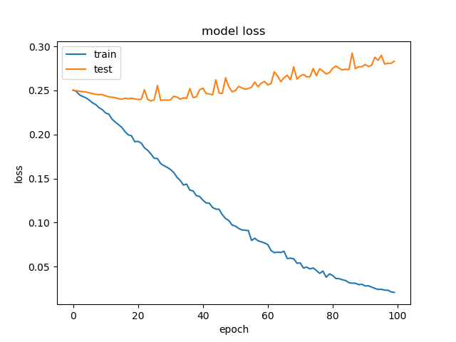
The Performance of Window Size=500, Cutoff of avg(Methyl)=5, #Seqs=2K (1K for pos and 1K for neg)
TP | FN
FP | TN
233 | 167
174 | 226
Sensitivity = 0.583
Specificity = 0.565

Slide 22
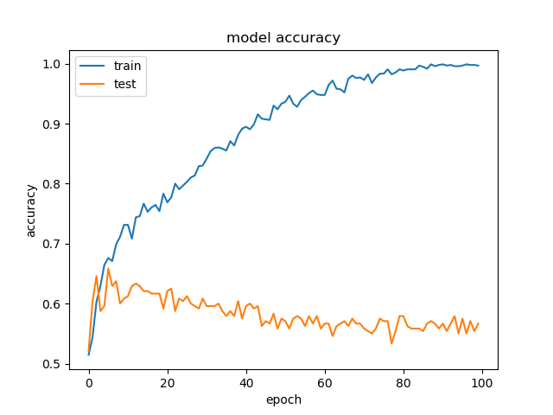
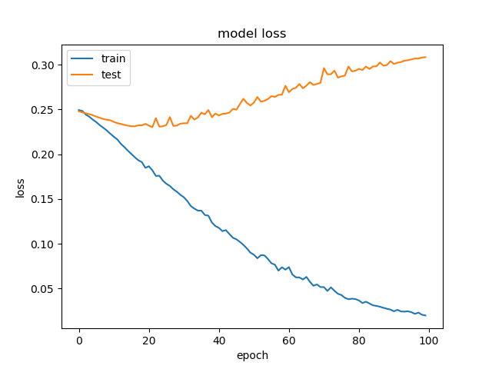
The Performance of Window Size=500, Cutoff of avg(Methyl)=10, #Seqs=2K (1K for pos and 1K for neg)
TP | FN
FP | TN
228 | 172
182 | 218
Sensitivity = 0.57
Specificity = 0.545

Slide 23
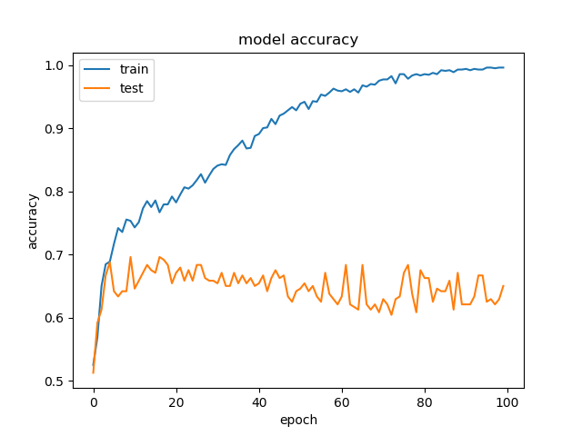
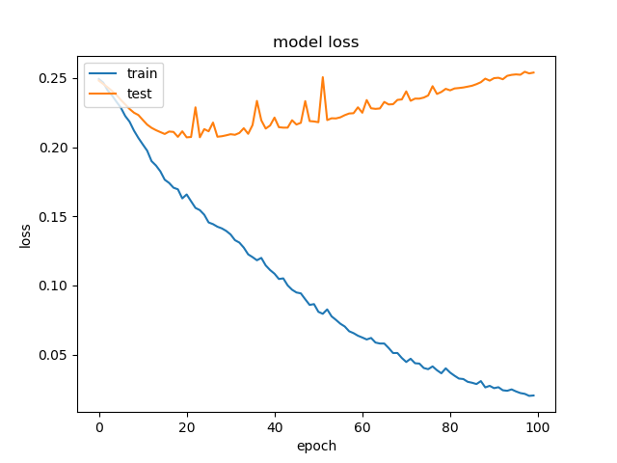
The Performance of Window Size=500, Cutoff of avg(Methyl)=15, #Seqs=2K (1K for pos and 1K for neg)
TP | FN
FP | TN
227 | 173
131 | 269
Sensitivity = 0.568
Specificity = 0.673

Slide 24
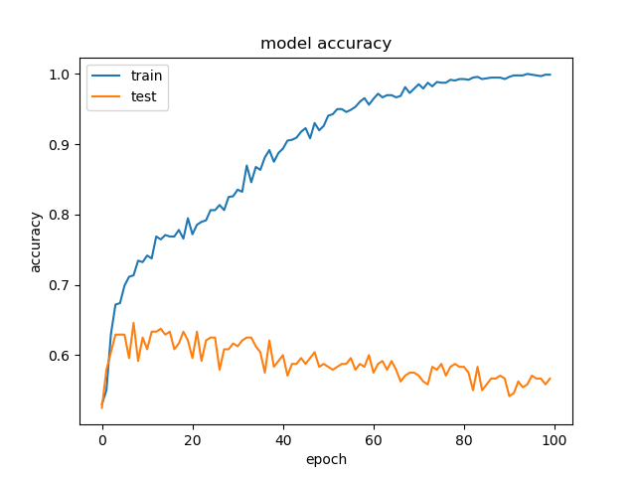
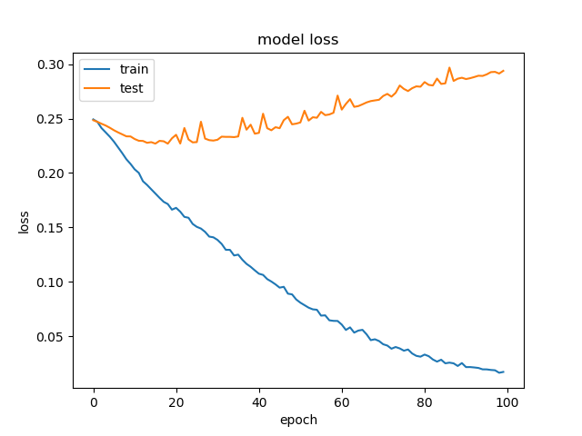
The Performance of Window Size=500, Cutoff of avg(Methyl)=20, #Seqs=2K (1K for pos and 1K for neg)
TP | FN
FP | TN
228 | 172
143 | 257
Sensitivity = 0.57
Specificity = 0.643

Slide 25
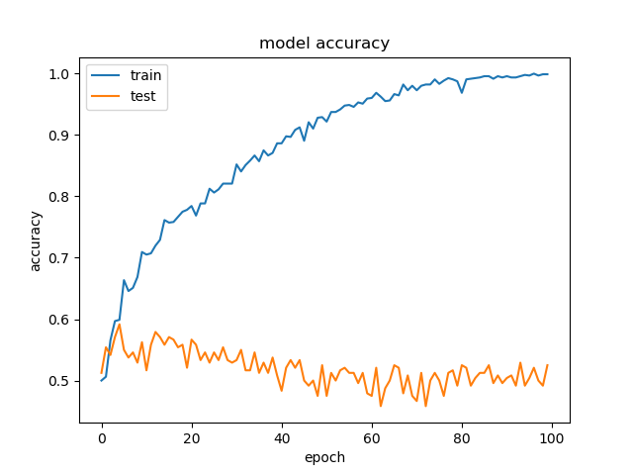
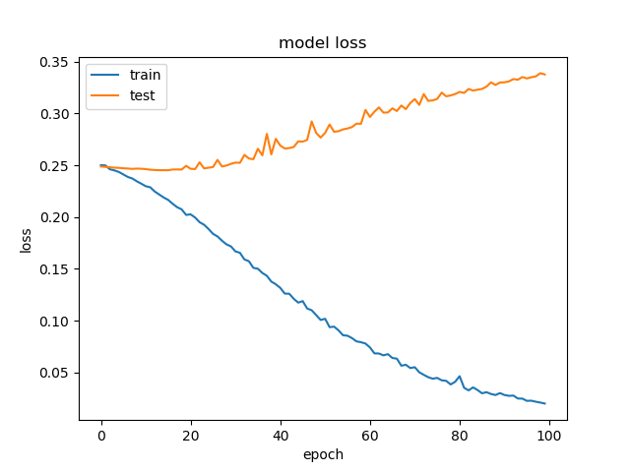
The Performance of Window Size=500, Cutoff of max(Methyl)=5, #Seqs=2K (1K for pos and 1K for neg)
TP | FN
FP | TN
184 | 216
173 | 227
Sensitivity = 0.46
Specificity = 0.568

Slide 26
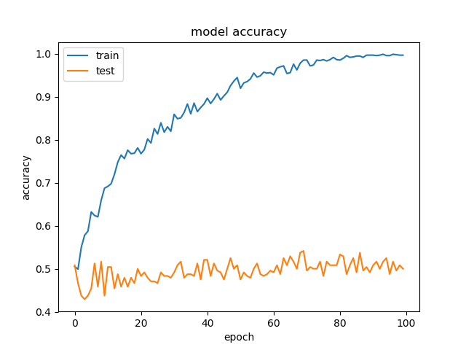
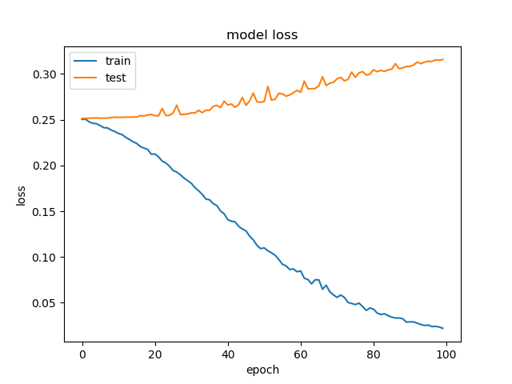
The Performance of Window Size=500, Cutoff of max(Methyl)=10, #Seqs=2K (1K for pos and 1K for neg)
TP | FN
FP | TN
216 | 184
195 | 205
Sensitivity = 0.54
Specificity = 0.513

Slide 27
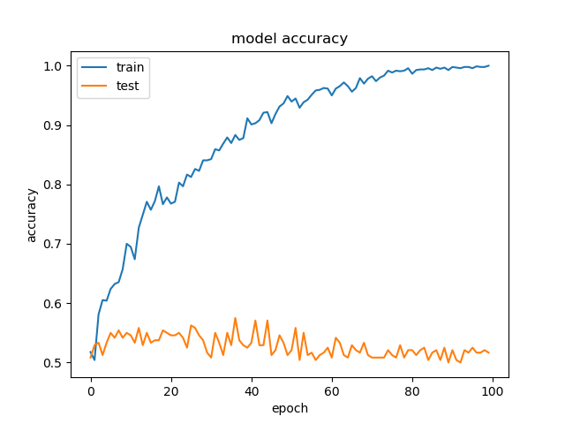
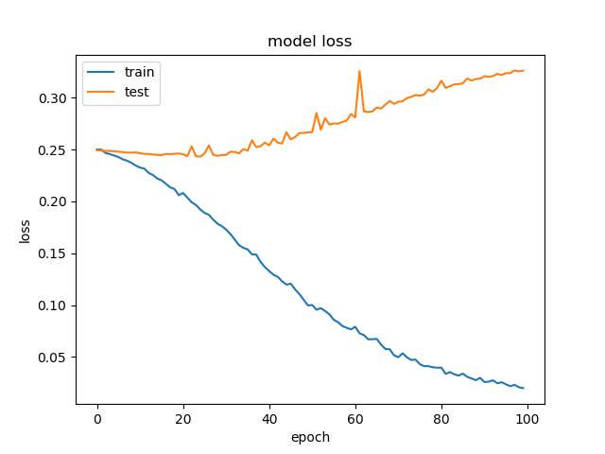
The Performance of Window Size=500, Cutoff of max(Methyl)=15, #Seqs=2K (1K for pos and 1K for neg)
TP | FN
FP | TN
219 | 181
207 | 193
Sensitivity = 0.548
Specificity = 0.483

Slide 28
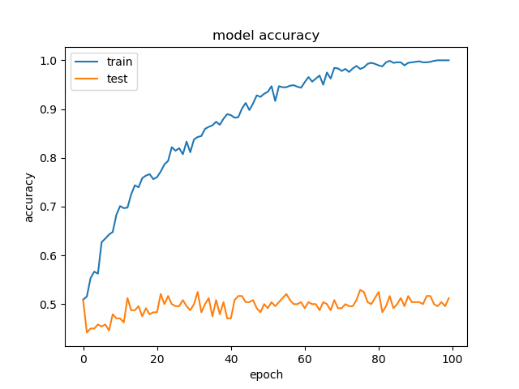
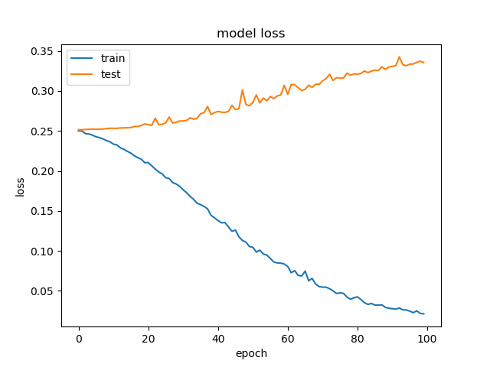
The Performance of Window Size=500, Cutoff of max(Methyl)=20, #Seqs=2K (1K for pos and 1K for neg)
TP | FN
FP | TN
187 | 213
173 | 227
Sensitivity = 0.468
Specificity = 0.568

Slide 29
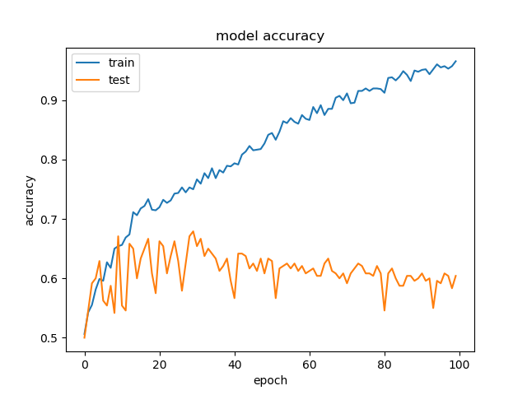
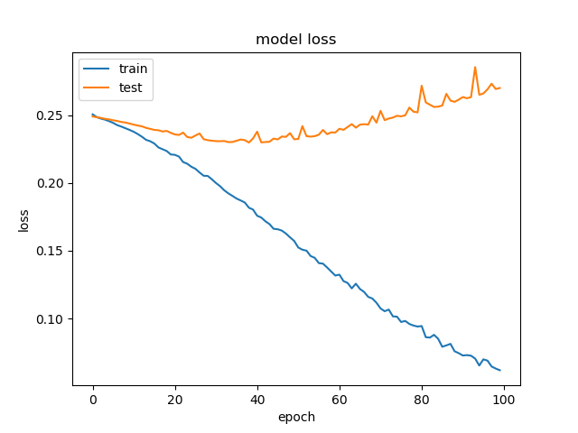
The Performance of Window Size=300, Cutoff of avg(Methyl)=5, #Seqs=2K (1K for pos and 1K for neg)
TP | FN
FP | TN
268 | 132
243 | 157
Sensitivity = 0.67
Specificity = 0.393

Slide 30
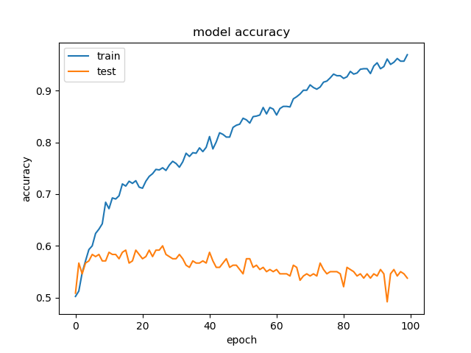
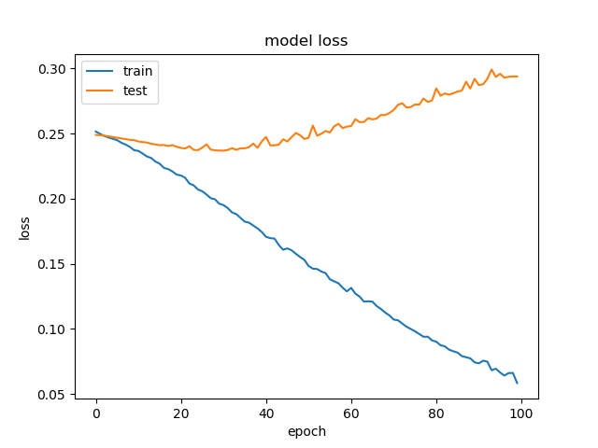
The Performance of Window Size=300, Cutoff of avg(Methyl)=10, #Seqs=2K (1K for pos and 1K for neg)
TP | FN
FP | TN
225 | 175
169 | 231
Sensitivity = 0.563
Specificity = 0.578

Slide 31
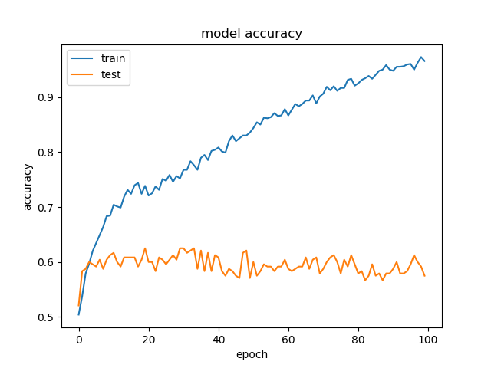
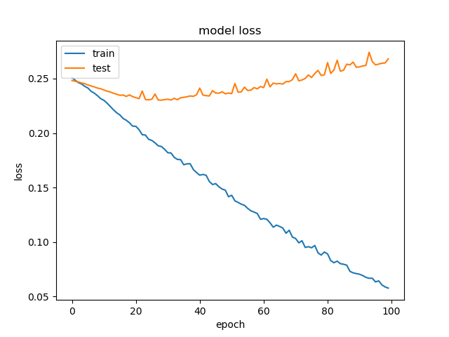
The Performance of Window Size=300, Cutoff of avg(Methyl)=15, #Seqs=2K (1K for pos and 1K for neg)
TP | FN
FP | TN
215 | 185
164 | 236
Sensitivity = 0.538
Specificity = 0.59

Slide 32
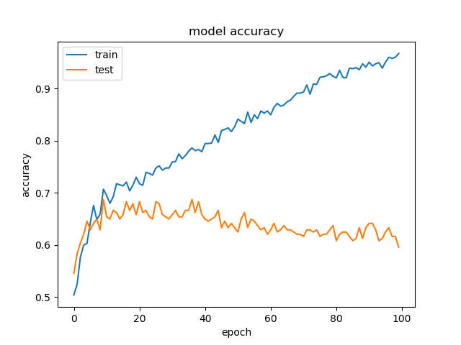
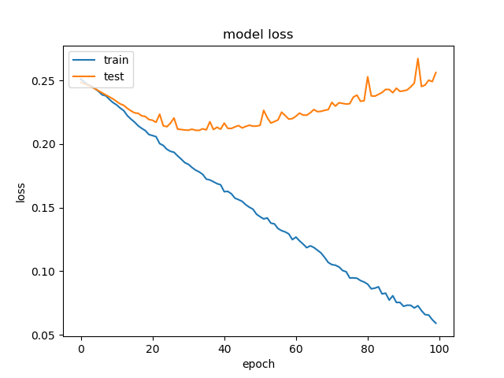
The Performance of Window Size=300, Cutoff of avg(Methyl)=20, #Seqs=2K (1K for pos and 1K for neg)
TP | FN
FP | TN
208 | 192
145 | 255
Sensitivity = 0.52
Specificity = 0.638

Slide 33
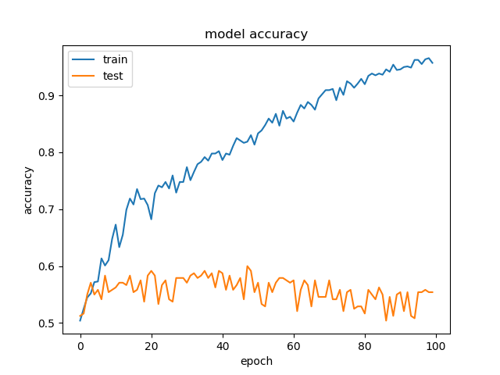

The Performance of Window Size=300, Cutoff of max(Methyl)=5, #Seqs=2K (1K for pos and 1K for neg)
TP | FN
FP | TN
220 | 180
204 | 196
Sensitivity = 0.55
Specificity = 0.49

Slide 34


The Performance of Window Size=300, Cutoff of max(Methyl)=10, #Seqs=2K (1K for pos and 1K for neg)
TP | FN
FP | TN
239 | 161
205 | 195
Sensitivity = 0.598
Specificity = 0.488

Slide 35


The Performance of Window Size=300, Cutoff of max(Methyl)=15, #Seqs=2K (1K for pos and 1K for neg)
TP | FN
FP | TN
182 | 218
183 | 217
Sensitivity = 0.455
Specificity = 0.543

Slide 36


The Performance of Window Size=300, Cutoff of max(Methyl)=20, #Seqs=2K (1K for pos and 1K for neg)
TP | FN
FP | TN
184 | 216
177 | 223
Sensitivity = 0.46
Specificity = 0.558

Slide 37


The Performance of Window Size=200, Cutoff of avg(Methyl)=5, #Seqs=2K (1K for pos and 1K for neg)
TP | FN
FP | TN
225 | 175
206 | 194
Sensitivity = 0.563
Specificity = 0.485

Slide 38


The Performance of Window Size=200, Cutoff of avg(Methyl)=10, #Seqs=2K (1K for pos and 1K for neg)
TP | FN
FP | TN
188 | 212
169 | 231
Sensitivity = 0.47
Specificity = 0.578

Slide 39


The Performance of Window Size=200, Cutoff of avg(Methyl)=15, #Seqs=2K (1K for pos and 1K for neg)
TP | FN
FP | TN
226 | 174
201 | 199
Sensitivity = 0.565
Specificity = 0.498

Slide 40


The Performance of Window Size=200, Cutoff of avg(Methyl)=20, #Seqs=2K (1K for pos and 1K for neg)
TP | FN
FP | TN
186 | 214
143 | 257
Sensitivity = 0.465
Specificity = 0.643

Slide 41


The Performance of Window Size=200, Cutoff of max(Methyl)=5, #Seqs=2K (1K for pos and 1K for neg)
TP | FN
FP | TN
175 | 225
135 | 265
Sensitivity = 0.438
Specificity = 0.663

Slide 42


The Performance of Window Size=200, Cutoff of max(Methyl)=10, #Seqs=2K (1K for pos and 1K for neg)
TP | FN
FP | TN
205 | 195
170 | 230
Sensitivity = 0.513
Specificity = 0.575

Slide 43


The Performance of Window Size=200, Cutoff of max(Methyl)=15, #Seqs=2K (1K for pos and 1K for neg)
TP | FN
FP | TN
217 | 183
193 | 207
Sensitivity = 0.543
Specificity = 0.518

Slide 44


The Performance of Window Size=200, Cutoff of max(Methyl)=20, #Seqs=2K (1K for pos and 1K for neg)
TP | FN
FP | TN
196 | 204
197 | 203
Sensitivity = 0.49
Specificity = 0.508

Slide 45
Aim: Decrease the distance between train and test Method: 1. rectify parameters: learning rate, loss function, and so on. 2. change other models. Test sampe data: windowsize =1000, cutoff of max(Methyl)=5, #Seqs=2W (1W for pos and 1W for neg)
Improvement

Slide 46
Improvement
Aim
Decrease the distance between train and test
Method
rectify parameters: learning rate, loss function, and so on.
change other models.
Test sample data
Window size =1000, cutoff of max(Methyl)=5, #Seqs=2W (1W for pos and 1W for neg)

Slide 47

Learning Rate
From 0.0001, 0.001, 0.01 to 0.1

Slide 48
LR = 0.0001 Loss=mean_squared_error
TP | FN
FP | TN
2505 | 1493
2305 | 1695
Sensitivity = 0.627
Specificity = 0.423

Slide 49
LR = 0.001 Loss=mean_squared_error
TP | FN
FP | TN
2258 | 1742
2108 | 1892
Sensitivity = 0.565
Specificity = 0.473

Slide 50
LR = 0.01 Loss=mean_squared_error
TP | FN
FP | TN
2237 | 1763
2045 | 1955
Sensitivity = 0.559
Specificity = 0.489

Slide 51
LR = 0.1 Loss=mean_squared_error
TP | FN
FP | TN
2296 | 1704
2045 | 1955
Sensitivity = 0.574
Specificity = 0.489

Slide 52
LR = 0.0001 Loss=mean_absolute_error
TP | FN
FP | TN
2711 | 1289
2289 | 1711
Sensitivity = 0.678
Specificity = 0.428

Slide 53
LR = 0.001 Loss=mean_absolute_error
TP | FN
FP | TN
2465 | 1535
2279 | 1721
Sensitivity = 0.616
Specificity = 0.430

Slide 54
LR = 0.01 Loss=mean_absolute_error
TP | FN
FP | TN
0 | 4000
0 | 4000
Sensitivity = 0
Specificity = 1

Slide 55
LR = 0.1 Loss=mean_absolute_error
TP | FN
FP | TN
0 | 4000
0 | 4000
Sensitivity = 0
Specificity = 1

Slide 56
LR = 0.0001 Loss=mean_absolute_percentage_error
TP | FN
FP | TN
Sensitivity =
Specificity =

Slide 57
LR = 0.001 Loss=mean_absolute_percentage_error
TP | FN
FP | TN
Sensitivity =
Specificity =

Slide 58
LR = 0.01 Loss=mean_absolute_percentage_error
TP | FN
FP | TN
Sensitivity =
Specificity =

Slide 59
LR = 0.1 Loss=mean_absolute_percentage_error
TP | FN
FP | TN
Sensitivity =
Specificity =

Slide 60
LR = 0.0001 Loss=mean_squared_logarithmic_error
TP | FN
FP | TN
Sensitivity =
Specificity =

Slide 61
LR = 0.001 Loss=mean_squared_logarithmic_error
TP | FN
FP | TN
Sensitivity =
Specificity =

Slide 62
LR = 0.01 Loss=mean_squared_logarithmic_error
TP | FN
FP | TN
Sensitivity =
Specificity =

Slide 63
LR = 0.1 Loss=mean_squared_logarithmic_error
TP | FN
FP | TN
Sensitivity =
Specificity =

Slide 64
LR = 0.0001 Loss= squared_hinge
TP | FN
FP | TN
Sensitivity =
Specificity =

Slide 65
LR = 0.001 Loss= squared_hinge
TP | FN
FP | TN
Sensitivity =
Specificity =

Slide 66
LR = 0.01 Loss= squared_hinge
TP | FN
FP | TN
Sensitivity =
Specificity =

Slide 67
LR = 0.1 Loss= squared_hinge
TP | FN
FP | TN
Sensitivity =
Specificity =

Slide 68
Default LR Loss= hinge
TP | FN
FP | TN
Sensitivity =
Specificity =

Slide 69
LR = 0.0001 Loss=hinge
TP | FN
FP | TN
Sensitivity =
Specificity =

Slide 70
LR = 0.001 Loss= hinge
TP | FN
FP | TN
Sensitivity =
Specificity =

Slide 71
LR = 0.01 Loss= hinge
TP | FN
FP | TN
Sensitivity =
Specificity =

Slide 72
LR = 0.1 Loss= hinge
TP | FN
FP | TN
Sensitivity =
Specificity =

Slide 73
Default LR Loss= categorical_hinge
TP | FN
FP | TN
Sensitivity =
Specificity =

Slide 74
LR = 0.0001 Loss= categorical_hinge
TP | FN
FP | TN
Sensitivity =
Specificity =

Slide 75
LR = 0.001 Loss= categorical_hinge
TP | FN
FP | TN
Sensitivity =
Specificity =

Slide 76
LR = 0.01 Loss= categorical_hinge
TP | FN
FP | TN
Sensitivity =
Specificity =

Slide 77
LR = 0.1 Loss= categorical_hinge
TP | FN
FP | TN
Sensitivity =
Specificity =

Slide 78
Default LR Loss= logcosh
TP | FN
FP | TN
Sensitivity =
Specificity =

Slide 79
LR = 0.0001 Loss= logcosh
TP | FN
FP | TN
Sensitivity =
Specificity =

Slide 80
LR = 0.001 Loss= logcosh
TP | FN
FP | TN
Sensitivity =
Specificity =

Slide 81
LR = 0.01 Loss= logcosh
TP | FN
FP | TN
Sensitivity =
Specificity =

Slide 82
LR = 0.1 Loss= logcosh
TP | FN
FP | TN
Sensitivity =
Specificity =

Slide 83
LR = 0.0001 Loss= categorical_crossentropy
TP | FN
FP | TN
Sensitivity =
Specificity =

Slide 84
LR = 0.001 Loss= categorical_crossentropy
TP | FN
FP | TN
Sensitivity =
Specificity =

Slide 85
LR = 0.01 Loss= categorical_crossentropy
TP | FN
FP | TN
Sensitivity =
Specificity =

Slide 86
LR = 0.1 Loss= categorical_crossentropy
TP | FN
FP | TN
Sensitivity =
Specificity =

Slide 87
LR = 0.0001 Loss= sparse_categorical_crossentropy
TP | FN
FP | TN
Sensitivity =
Specificity =

Slide 88
LR = 0.001 Loss= sparse_categorical_crossentropy
TP | FN
FP | TN
Sensitivity =
Specificity =

Slide 89
LR = 0.01 Loss= sparse_categorical_crossentropy
TP | FN
FP | TN
Sensitivity =
Specificity =

Slide 90
LR = 0.1 Loss= sparse_categorical_crossentropy
TP | FN
FP | TN
Sensitivity =
Specificity =

Slide 91
LR = 0.0001 Loss= binary_crossentropy
TP | FN
FP | TN
Sensitivity =
Specificity =

Slide 92
LR = 0.001 Loss= binary_crossentropy
TP | FN
FP | TN
Sensitivity =
Specificity =

Slide 93
LR = 0.01 Loss= binary_crossentropy
TP | FN
FP | TN
Sensitivity =
Specificity =

Slide 94
LR = 0.1 Loss= binary_crossentropy
TP | FN
FP | TN
Sensitivity =
Specificity =

Slide 95
Default LR Loss= kullback_leibler_divergence
TP | FN
FP | TN
Sensitivity =
Specificity =

Slide 96
LR = 0.0001 Loss= kullback_leibler_divergence
TP | FN
FP | TN
Sensitivity =
Specificity =

Slide 97
LR = 0.001 Loss= kullback_leibler_divergence
TP | FN
FP | TN
Sensitivity =
Specificity =

Slide 98
LR = 0.01 Loss= kullback_leibler_divergence
TP | FN
FP | TN
Sensitivity =
Specificity =

Slide 99
LR = 0.1 Loss= kullback_leibler_divergence
TP | FN
FP | TN
Sensitivity =
Specificity =

Slide 100
Default LR Loss= poisson
TP | FN
FP | TN
Sensitivity =
Specificity =

Slide 101
LR = 0.0001 Loss= poisson
TP | FN
FP | TN
Sensitivity =
Specificity =

Slide 102
LR = 0.001 Loss= poisson
TP | FN
FP | TN
Sensitivity =
Specificity =

Slide 103
LR = 0.01 Loss= poisson
TP | FN
FP | TN
Sensitivity =
Specificity =

Slide 104
LR = 0.1 Loss= poisson
TP | FN
FP | TN
Sensitivity =
Specificity =

Slide 105
LR = 0.0001 Loss= cosine_proximity
TP | FN
FP | TN
Sensitivity =
Specificity =

Slide 106
LR = 0.001 Loss= cosine_proximity
TP | FN
FP | TN
Sensitivity =
Specificity =

Slide 107
LR = 0.01 Loss= cosine_proximity
TP | FN
FP | TN
Sensitivity =
Specificity =

Slide 108
LR = 0.1 Loss= cosine_proximity
TP | FN
FP | TN
Sensitivity =
Specificity =

Slide 109
Summary And Conclusion
We could try to predict CTCF binding via GC methylation signal using deep learning algorithms.
Increasing the number of samples (#seqs) can improve the performance.
Increasing the number of CNN can improve the performance, but may cause overfitting.

Slide 110
Future Plan
Rectify parameters

Slide 111
Acknowledgements
Dr. Xi WANG

Slide 112
Thanks for Your Attention And Criticism！
Notes:
Finally, thanks my advisor, Professor YAN and Dr. WANG. Thanks for the findings. I will stop here and take questions.

